Slide 1
TSIA Group Meeting
August 22, 2019

Slide 2
Performance feedback development plan (PFDP)
Scope
• Regular and limited-term employees, postdocs, and interns hired before July 1, 2019
• Performance is tracked by fiscal year (October 1–September 30), and evaluations occur each fall.
Purpose
To help members of SCEA effectively complete the performance appraisal process. Through this process, we aim to:
• Provide feedback on how well individuals are meeting performance expectations
• Inform salary increases in a manner consistent with assessed performance
• Be fair, consistent, inclusive, and data-driven
• Provide guidance on planning and professional development needs for the following fiscal year
• Support individuals’ long-term professional development
• Identify candidates for promotion

Slide 3
Performance feedback development plan (PFDP)
Principles
• At least two levels of management will be engaged in each review; no review result will be determined by a single individual.
• Performance will be assessed relative to peers and HR level guides (not absolute with respect to goals).
• Centers should display results in a manner that shows they are internally consistent.
• It is expected that candidates for promotion will have demonstrated multiyear, sustained high performance at their current level. In most cases this will be reflected in “exceptional” ratings, but there may be exceptions to this to accommodate unusual circumstances.
• Decisions in the review process will reflect NREL’s values concerning diversity, equity, and inclusion.
• SCEA will observe Lab expectations with respect to the process and timeline.

Slide 4
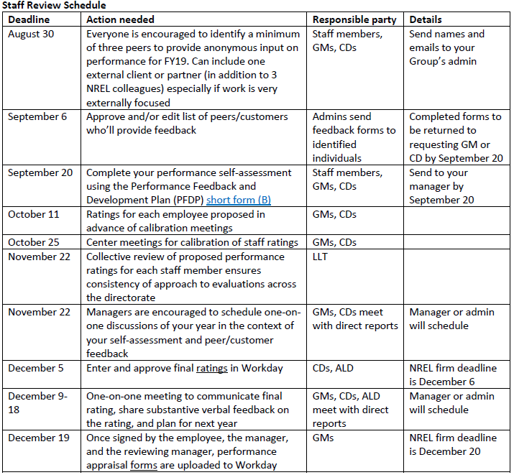
PFDP

Slide 5
The reality of promotions and raises at NREL – from Karlynn cory
We wish we could give everyone that deserved them promotions or big raises, but we are constrained
The prime contract between DOE-NREL controls raises, cost of living adjustments, promotions, etc.
Only about 10%-15% of the lab gets “Exceptional” every year.
And thus, 85%-90% “Meet/Exceed Expectations.
The reality is well over half (3/4? All?) of NREL staff would be exceptional anywhere else
Only 4%-5% of any team can get a promotion any year
4-5 people in a center of 100
We know many more deserve recognition.
We are frustrated that we cannot give more out.

Slide 6
PFDP Writing – from Karlynn cory
Be Concise.
Your manager has to read all PFDPs and peer reviews for everyone in your group. It takes a lot of time.
If you like to use your PFDP as a record of all of your accomplishments, provide an executive summary.
Talk about Impact.
Don’t just say what you did but talk about why it mattered and to whom.
Quantify When Possible.
“Submit X journal articles, published Y journal articles and published Z NREL technical reports.”
“My analysis showed $XMM -$YMM of savings to <client>.”
“The client decided to include Z technology in their research program as a direct result of my analysis.”
Balance What with How.
How you do things is as important as what you do. Add how you work with others on your PFDP. Talk about how your unique capabilities and solutions positively impact the team.

Slide 7
PFDP Writing – from Karlynn cory
Create a Brag Folder.
Put all those accolades you get throughout the year from everything into a brag folder (thanks Maggie Mann!). Then they are then ready for your PFDP.
Gather Quotes.
Client/colleague quotes are helpful, Even “Thank you!”
Go Ahead and Brag.
Don’t assume your manager will remember that key awesome thing you did –remind them.
When showcasing yourself –don’t be shy!

Slide 8
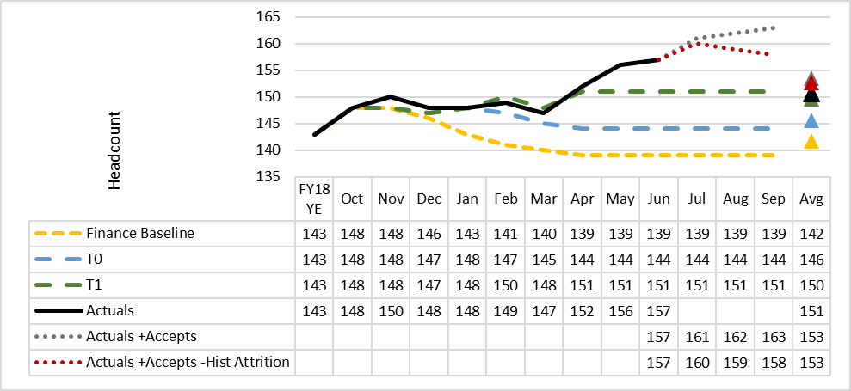
SEAC Headcount – excluding interns
Transfer adjustments: -1 to ESI, -1 to IPID, -4 to MTES, -1 to IPO = -7 total
Hiring exceeded T1 target!
Staff growth of 14 compared to T1 target of 8

Slide 9
Process change – details and ipas
This process change now requires NREL to comply with the following effective immediately:
All detail assignments including strategic partnership projects (SPP) and management and operations (M&O) need Contracting Officer approval
Details include all assignments to any other place of employment including EERE technology offices
Process requires EE-1 (Assistant Secretary, EERE) review and approval and 10 days' notice to S-3 (Office of the Under Secretary of Energy)
No detail assignments will be permitted to start until Contracting Officer approval is received in writing.
What does this mean?
All new detail assignments and assignments needing extension requests:
Must go through HR People.Services@nrel.gov
Must include justification with cost estimate and any relocation information for the assignment, if any
HR will process the request for Deputy Director/COO signature and transmittal to Contracting Officer for approval
Once Deputy Director/COO receives approval from Contracting Officer, HR will inform the requestor of the approval/disapproval
HR will process any actions relating to the assignment and relocation, as appropriate.

Slide 10
NREL Financials
Business volume: $485M for FY19,
Working to set the rates now – Direct Labor Multiplier will remain at 2.45
Business volume forecast will be up 6% to $508M
We are not looking to reduce overhead rates at all.
We need to position ourselves to be the best lab for renewables and climate and really be ready for the next big changes that might come.

Slide 11
Fy20 planning
Please do not plan yourself at 100%
Start thinking about time allocation for next year – does it move you in the direction of your career goals?
PIs – FY20 Plans due in EPP by 8/27!
DOE work – Enter best estimates based on current information available. Update EPP plans as AOPs are finalized in the coming months.
SPPs – There is nearly $7M of awarded SCEA led SPP work that is unplanned. LDRDs
Please plan all ongoing or newly awarded FY20 projects at the approved budget amounts.

